Slide 1


Communication 3
Lesson 5: Staying a hotel
Lesson 6: Choose a hotel

Slide 2
OBJECTIVES OF THE LESSON
01
02
03
VOCABULARY
GRAMMAR
READING
04
SPEAKING
Types of Room, Bed.
Services and Facilities
Request housekeeping services
Conditional Clause
Choose a hotel
Talk about the hotel that you have stayed in.

Slide 3
Have you ever stayed in a hotel?
Yes. I have stayed in a hotel, named Muong Thanh Hotel.
No. I haven’t …………………..

Slide 4
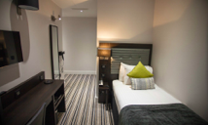
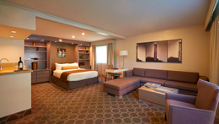
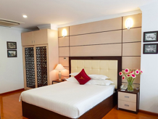
When you travel alone and don’t need much space, which room type will you stay in?
Well, when I travel alone and don’t need much space, I will stay in ………………….to save money.
-Single
-Double
-Suite

Slide 5
Vocabulary
Room types, types of bed

Slide 6
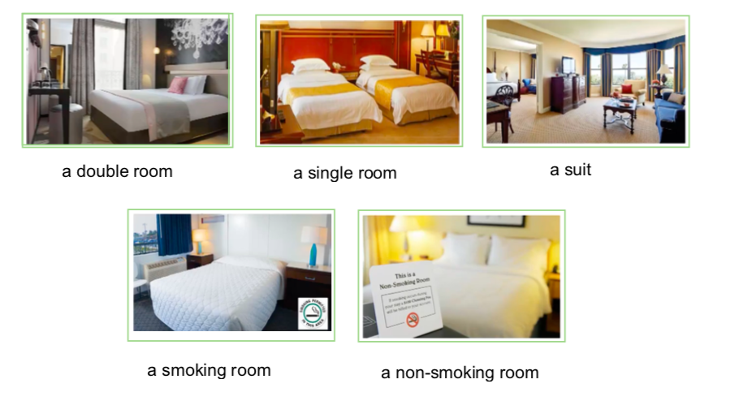
TYPES OF ROOM
Look at the pictures and guess the room types – 2 minutes
2
3
1
a double room
a suite
a single room
4
5

Slide 7
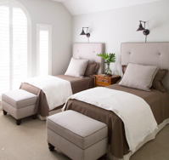
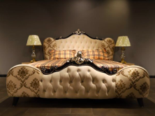
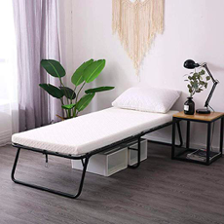
Pair work: ask and answer the question – 2 minutes When you want to save money by sharing a room with a colleague, which type of bed will you book?
Normally, I will book _____________ because I can ………
a twin bed
a queen-size bed
a rollaway

Slide 8
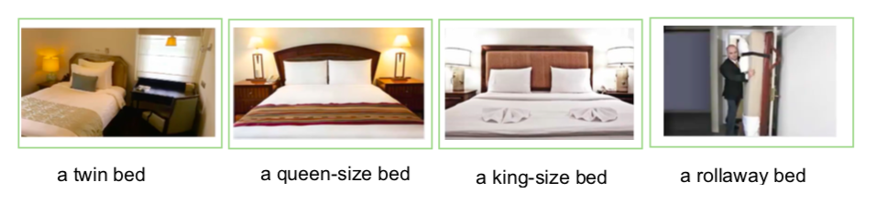
KINDS OF BED
Look at the pictures and guess the kinds of bed – 2 minutes
1
2
3
4

Slide 9
Pair work - CHOOSE ROOM TYPES OR TYPES OF BED – 2 minutes
Ms. Gleason is travelling alone. She doesn’t need much space…ROOM?
A single room
2. Mr. and Mrs.Vanite and their 12-year-old son Boris are checking into a room with one king-size bed…BED?
A rollaway bed
3. Mike Krause plans to use his room for business meetings with important customers…….ROOM?
A suite
4. George Nack is a big man, and he’s very tall. He needs a good night’s sleep for an important meeting tomorrow…BED?
A king-size bed
5. Paul Krohn’s company wants him to save some money by sharing a room with a colleague…BED?
Twin beds

Slide 10

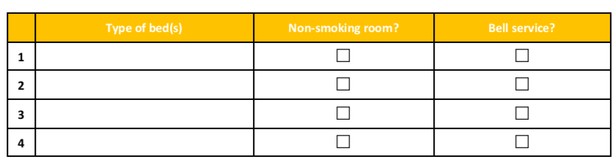



Complete the information about what
each guest need (10 minutes)
✅
✅
✅
✅
✅
✅
✅

Slide 11

Hotel room amenities and services

Slide 12
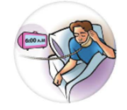





HOTEL SERVICES
Groupwork – Matching the pictures with hotel services – 2 minutes
4
1
Free airport shuttle:
Wireless internet service:
Pool and sauna:
In-room minibar:
24-hour room service:
Gift shop:
Business center:
Laundry service:
Shoeshine service:
Fitness/exercise center:
Wake-up service:
Bell/luggage service:
2
5
3
6

Slide 13
Work in pairs. Complete the conversation – 5 minutes
A:When was the last time you stayed in the hotel?
B: Let’s see. Well, I stayed in the hotel on my last vacation in Nha Trang city. The hotel’s name is Happy Stay.
A: Where is the hotel located?
B: Well, it is located on Tran Phu Street, near the beach and a shopping center, so it is very convenient for me to go to the beach to swim and eat seafood, and go shopping.
A: Really, what kind of room did you stay?
B: Well, I stayed in a double room with my friend but twin beds to share money.
A: Can you tell me what facilities or services did the hotel have?
B: The hotel had some facilities like swimming pool, fitness center, and a lot of services like free airport shuttle, laundry service, wake up service, and so on.

Slide 14

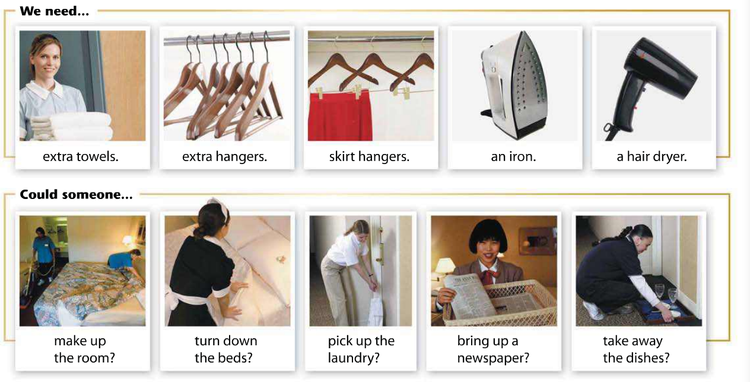
Groupwork Look at the pictures and guess hotel room amenities and services. 10 minutes. Then listen and repeat.
1
2
3
4
5
6
7
8
9
10

Slide 15
Complete the statements with other items you know.
Then compare items with your partner. 2 minutes
We need extra ……………………………………?
2. We also need ……………………………………..?
3. Could someone pick up my………………………?
4. Could someone bring up …………………..……?
5. Could someone take away ………………………?

Slide 16
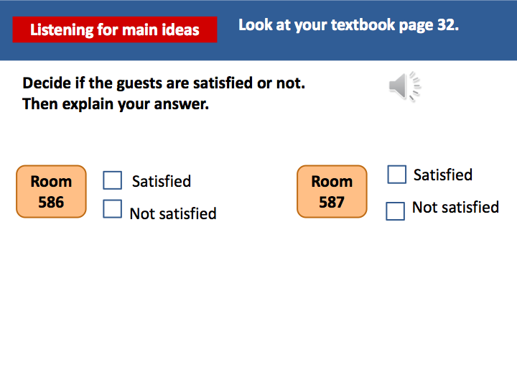

✅
✅

Slide 17

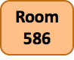





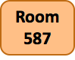



Listen again and complete each statement.
The guest wants someone to take away………………. ……….,
bring up …………………………… and …………………… and pick up …………………………… .
The guest wants someone to ………… ..the ………….,
bring up …………………………… and ………………………….
the ………………… .

Slide 18
A: Did you request any housekeeping services when staying at the hotel?
B: Yes, surely. When I stayed at the hotel, I requested the housekeeper to make up the room and pick up the laundry.
A: Were you satisfied with your stay?
B: Yes, of course. The hotel room was very nice. The staff was so friendly. However, sometimes there was noisy near my room.
Pair work: Ask and answer the questions - 5 minutes

Slide 19

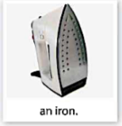
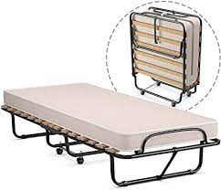
Group work: Guess the word or phrase about services and amenities - 2 minutes
a rollaway bed
1. If you have an extra person in your room, you will need to ask for
2. If you have a meeting at 8:30 in the morning, you can use .
3. If you need to make your clothes look nice, you should ask for .
4. If you don’t want to take a taxi to the airport, you can use .
5. If you brought a lot of clothes with you, you can ask for .
the wakeup service
an iron
the airport shuttle
extra hangers

Slide 20
GRAMMAR
Real Conditional

Slide 21
Pair work :Answer the questions below (2 minutes)
What will you do if you travel to Dalat city?
What will you buy if you go to a shopping center?
What type of room will you stay if you travel with your family ?

Slide 22
The conditional sentences express the results of actions or conditions
If clause If + simple present, | Result clause Simple present/ future tense
If I travel to Dalat city, I will drink hot soy milk and visit the night market.
I will buy a nice dress if I go to a shopping center.
If I travel with my family I will stay in a suit.

Slide 23
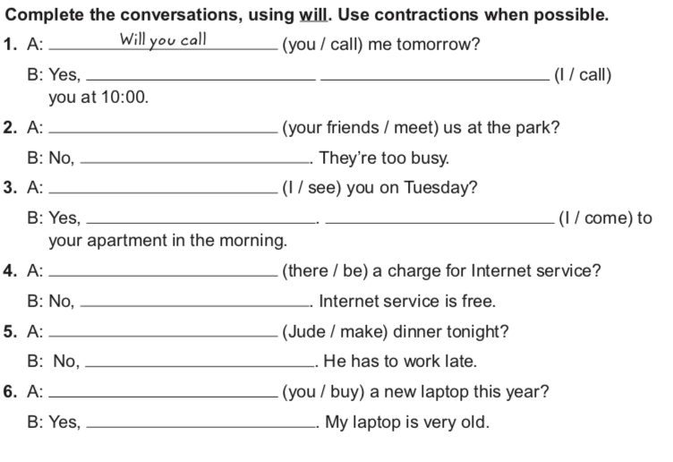
I will
I’ll call
Will your friends meet
they won’t
Will I see
Grammar Practice- 10 minutes
I will
I’ll come
Will there be
there won’t
Will Jude make
he won’t
Will you buy
I will

Slide 24
READING CHOOSE A HOTEL

Slide 25
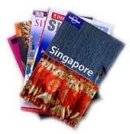

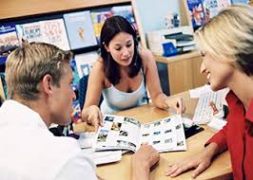
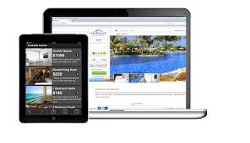
Before you read
Answer the question. 2 Minutes
What are some ways to get
information about a hotel?
By word of mouth
From a travel guide book
Other ?
From an online hotel
booking service
From a travel agency
Notes:
Write student responses on the board and rank them in order of popularity.

Slide 26
READING - 2 Minutes

Slide 27

Groupwork: Find information about the hotels in the passage- 5 minutes
Hotel name | Location | Facilities | Services | Price (rate 1- 4)

Slide 28
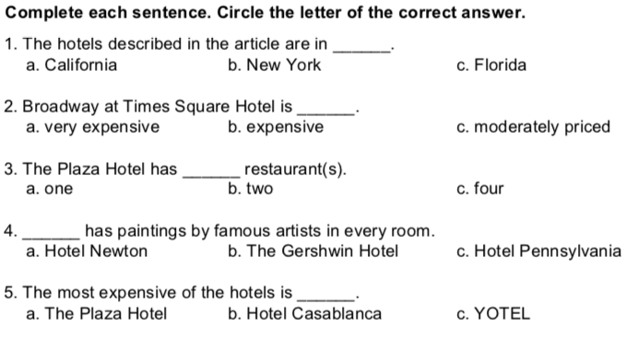
Pair work – Read the passage (2 minutes)

Slide 29
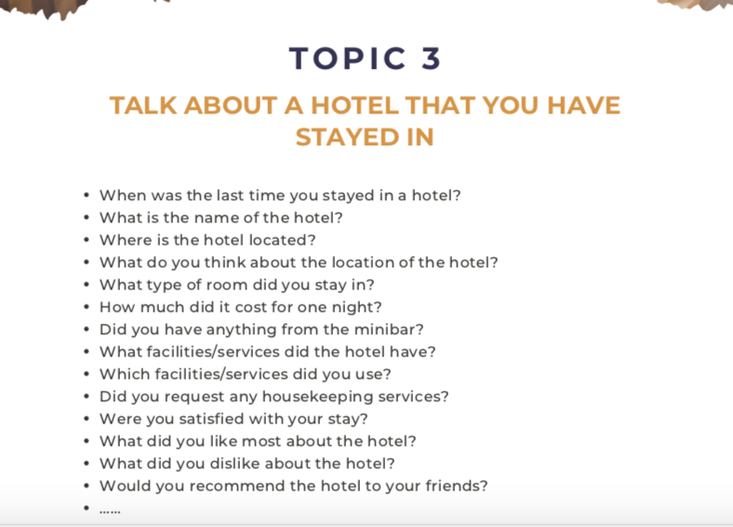

Slide 30
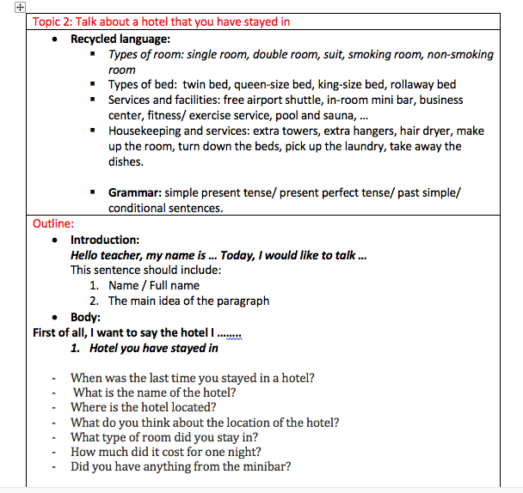
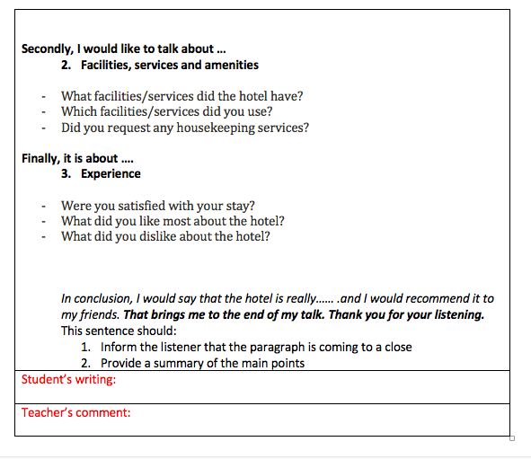
Writing format

Slide 31
What have we learnt today?
Consolidation
1. Types of Room, Bed.
2. Services and Facilities
3. Request housekeeping services
4. Conditional clause
5. How to choose a hotel
6. Talk about the hotel that you have stayed in

Slide 32


